Slide 1
GoRestaurant
Project Manager: Samuel Le
Developer: Leo Doan, Nguyen Hoang

Slide 2
Project Vision
FOR any kind of restaurant WHO would like to utilize the technologies in the 4.0 generation to expand their network, sell the food more widely, and reach out more customers, GoRestaurant is a Web-based service THAT helps restaurants create their own mobile app for ordering food online or making table reservations. Unlike other services, OUR product aims to produce a mobile app that gives a great experience of convenience for restaurant and their customers and create a friendly environment between them.

Slide 3
Managing
Involve: Project Manager.
Give the vision of project and explain the technologies should be implemented.
Planning and scheduling.
During process, using git to manage source code.
Check the change doesn’t contradict the idea embodies in project vision
Ensure the completion of software.
Ensure the project meet expected goals.

Slide 4
Code creation, Functional and Performance Implement
Involve: Developers.
Using mongoDB to create a database to store, access, and manage data from user.
Using Express to create the RESTfull APIs to create user account, their restaurant’s information, menu, etc.
Using ejs, and css to create UI layout for web page and restaurant’s mobile app.
Using jQuery, and ajax to communicate between back end and front end.

Slide 5
Testing, user beta, and deploy
Test the function and performance of product.
Test a beta of webpage service
Try to create a simple mobile app using the web have created.
Improve and fix the product if needed.
Publish the completed version to its intended users.

Slide 6
Process and demo
Developers (front/back end): Working on the register, log in, log out and UI layout.
Description: Project progress we are working for the users can register, log in and log out. Also we add all the picture, font , logo to make the UI Layout for the web page.
Technology: EJS, CSS , Node.js, MongoDB

Slide 7
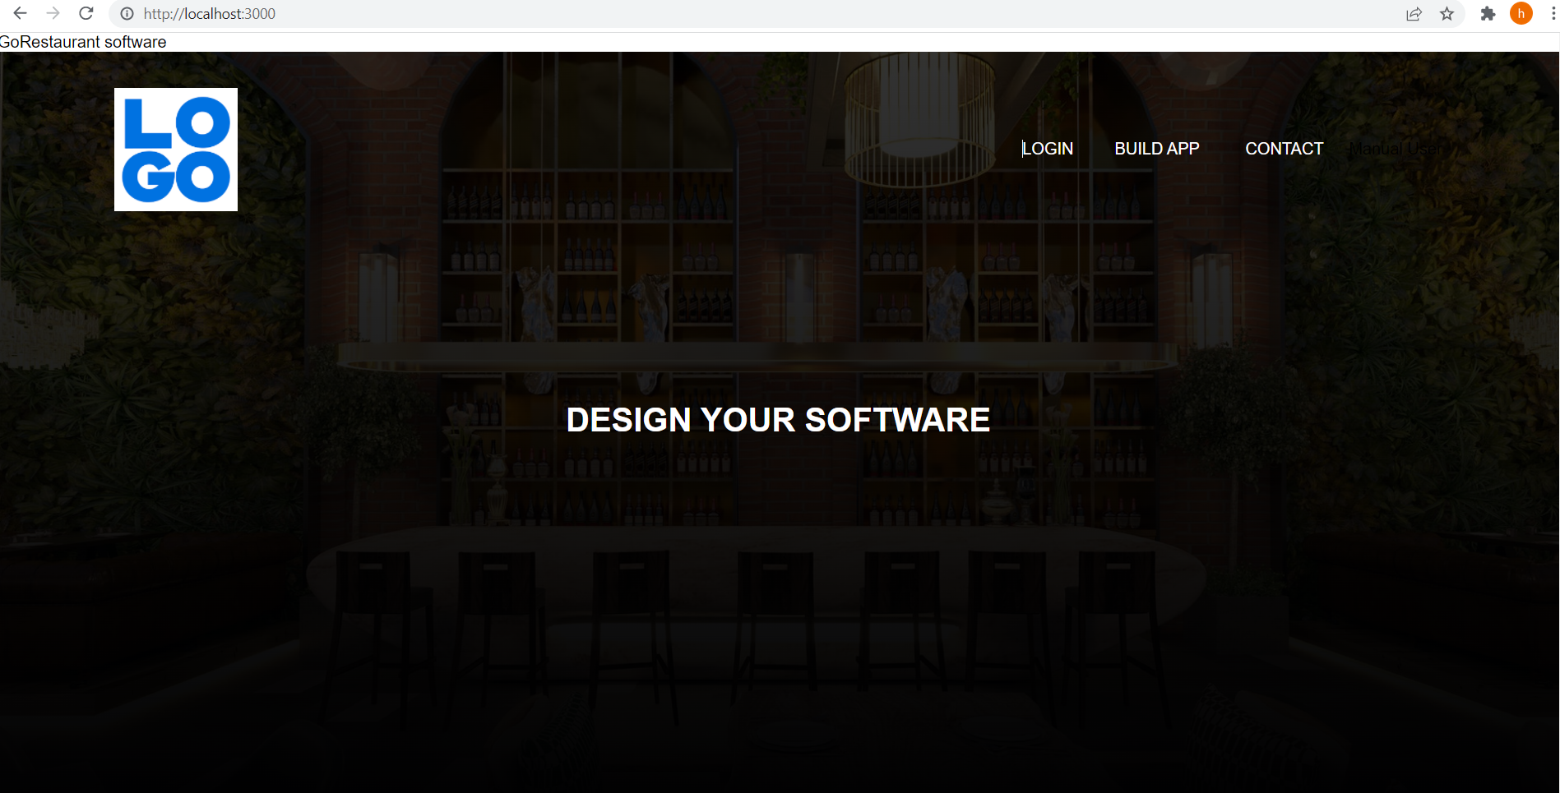
UI LayOut

Slide 8
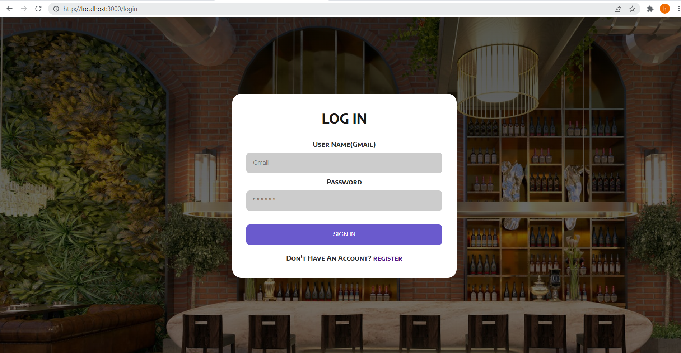
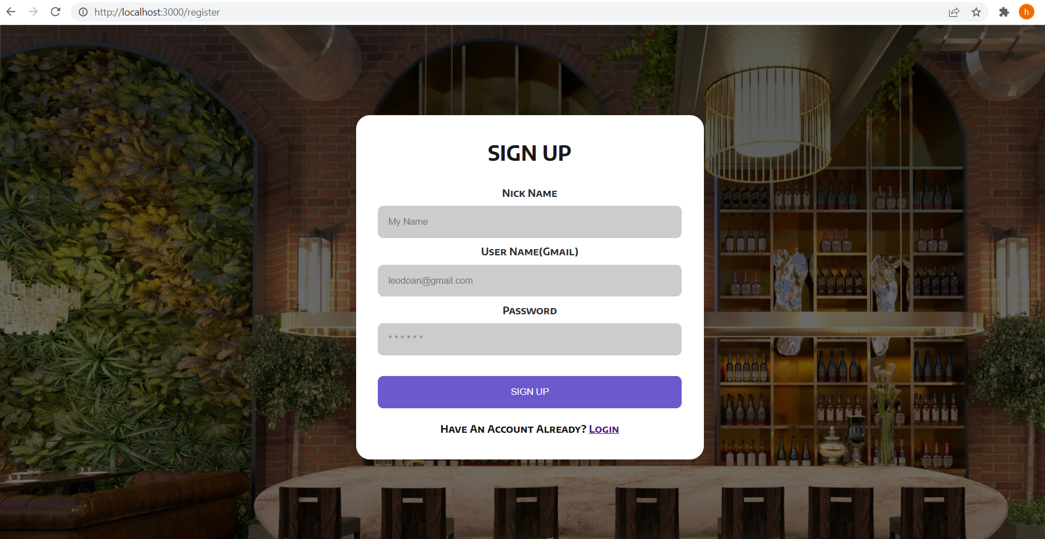
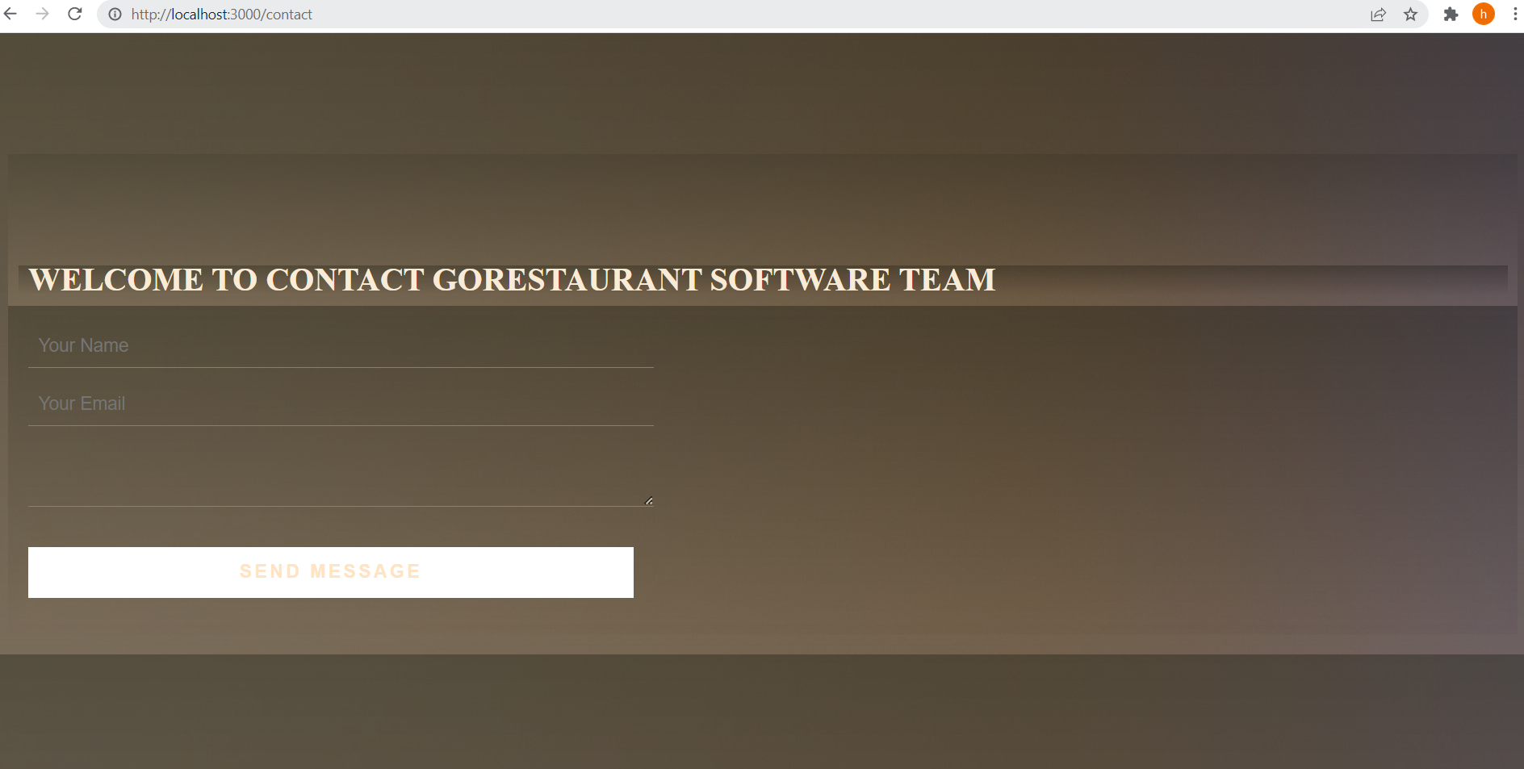
Log in and Register

Slide 9
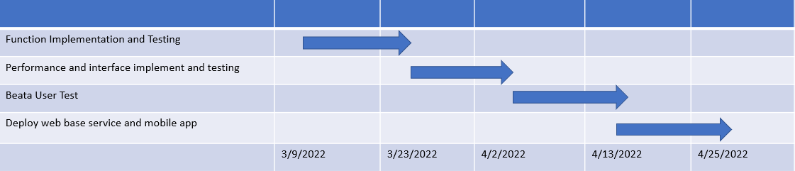
Timeline
● Functional implementing and testing - 3/9 to 3/23
● Performance and interface implement and testing - 3/24 to 4/2
● Beta user test - 4/2 to 4/13
● Deploy web base service and mobile app 4/13 to 4/25

